Slide 1
Presentation on Pods (Kubernetes)
Presented by :- Guided by :-
Rahul Bhati Ashish Sir

Slide 2
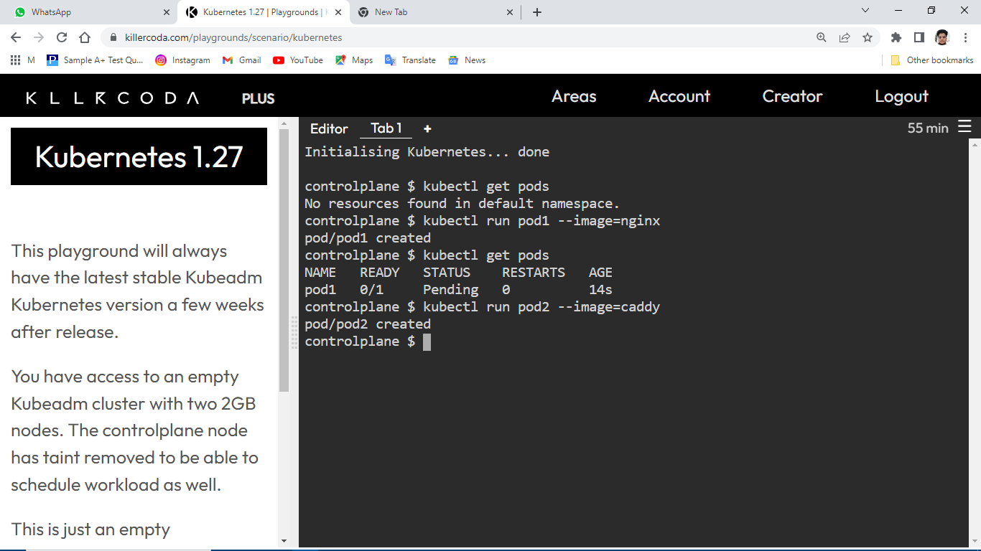

Slide 3
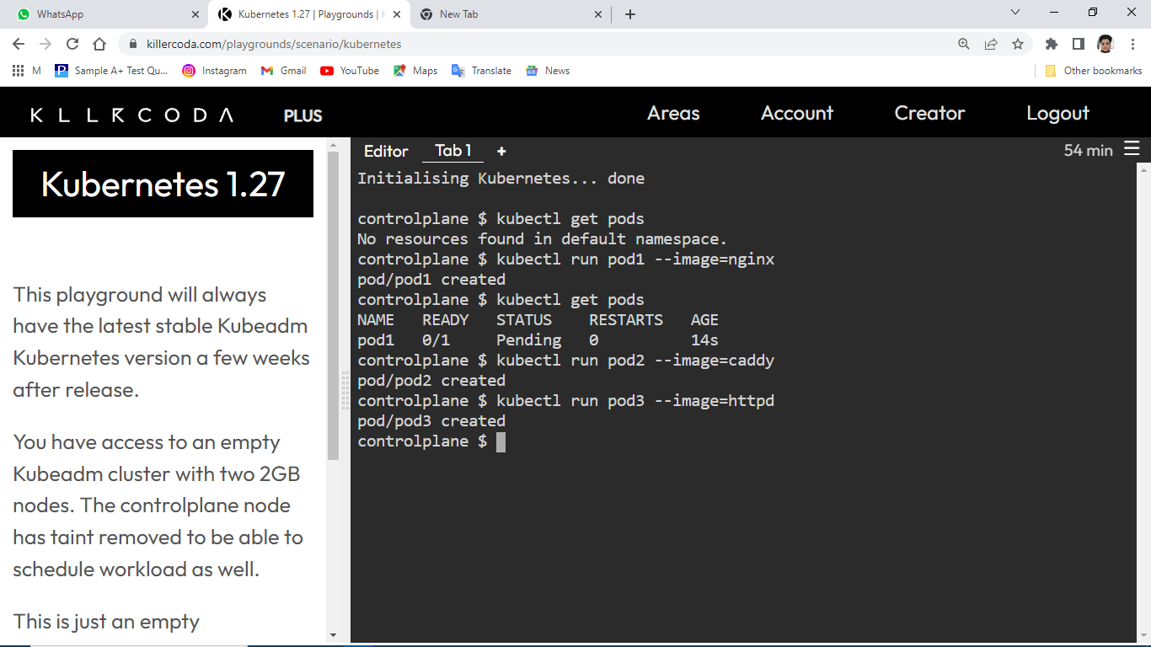

Slide 4


Slide 5
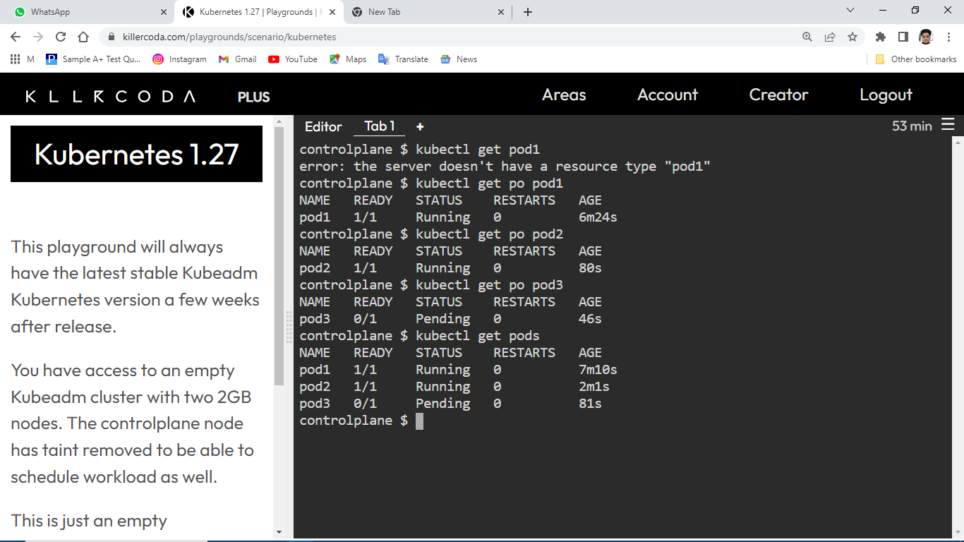

Slide 6
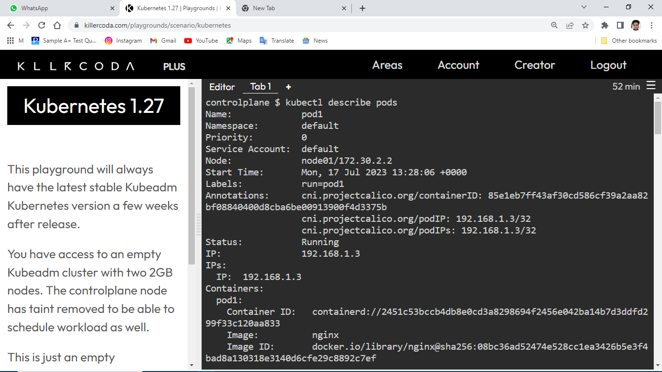

Slide 7
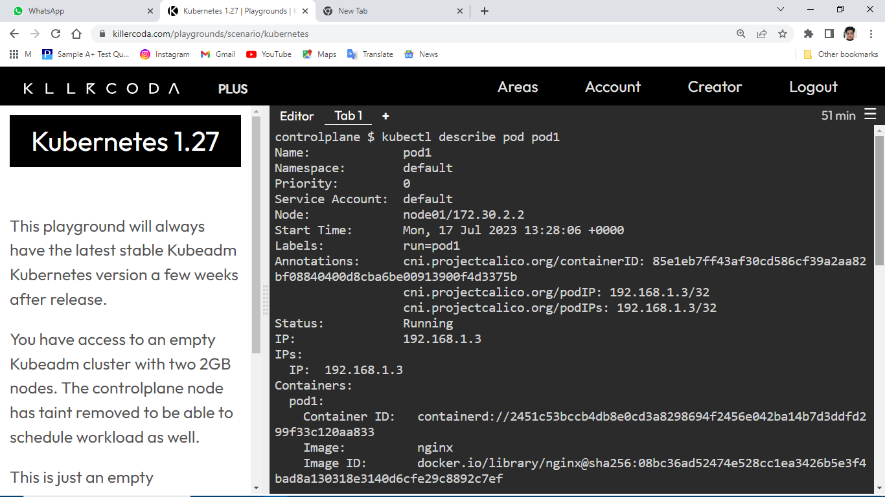

Slide 8
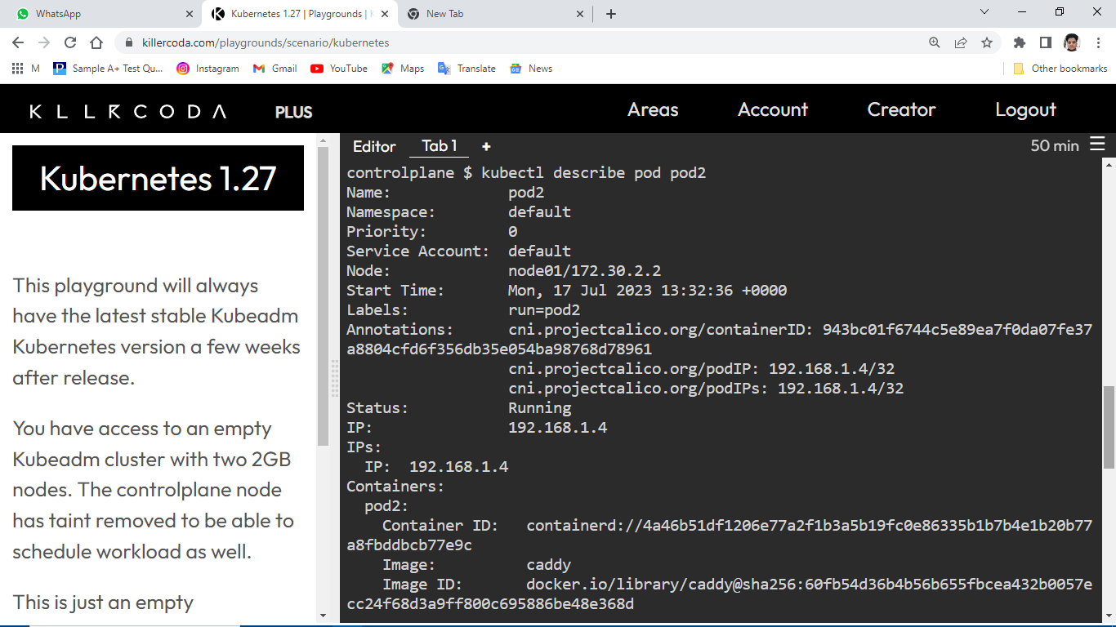

Slide 9


Slide 10
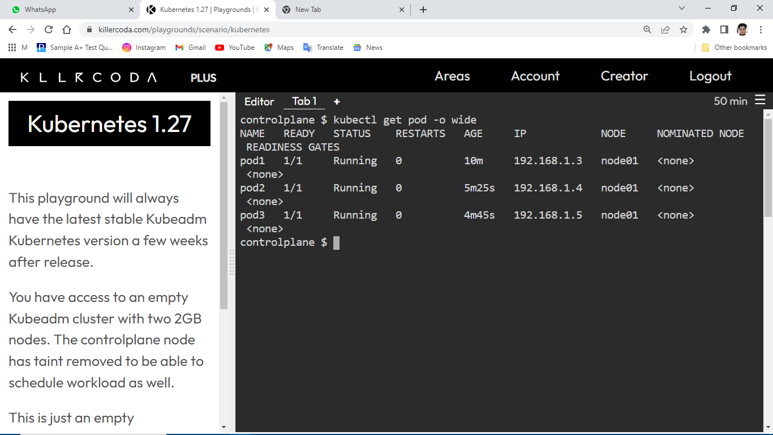

Slide 11


Slide 12
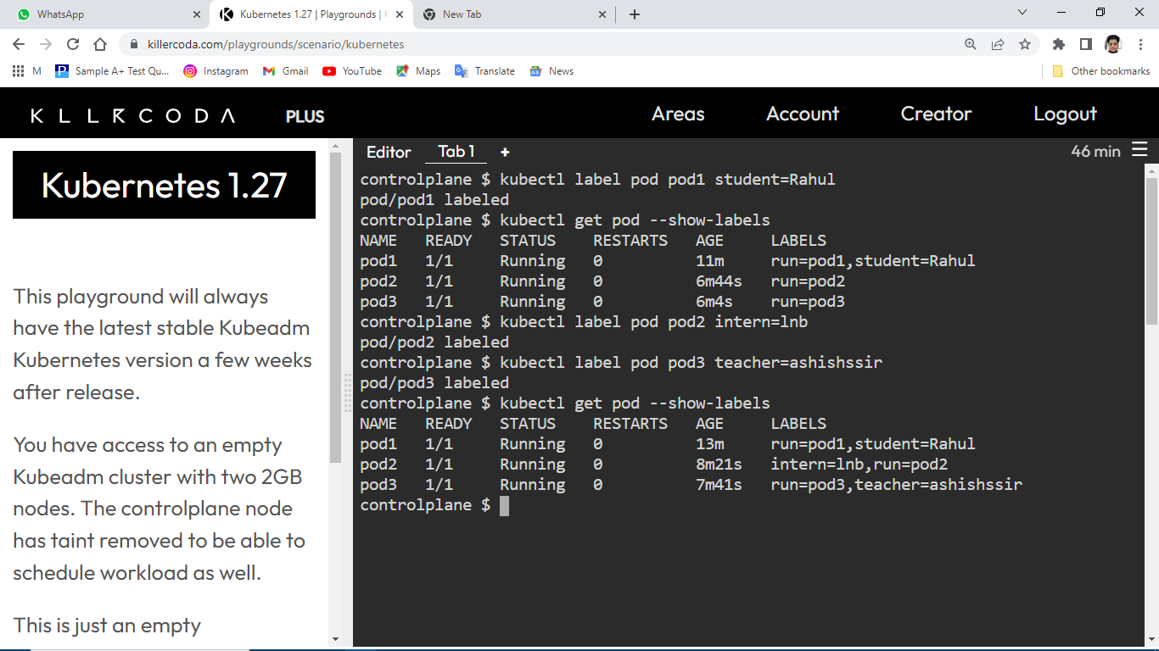

Slide 13
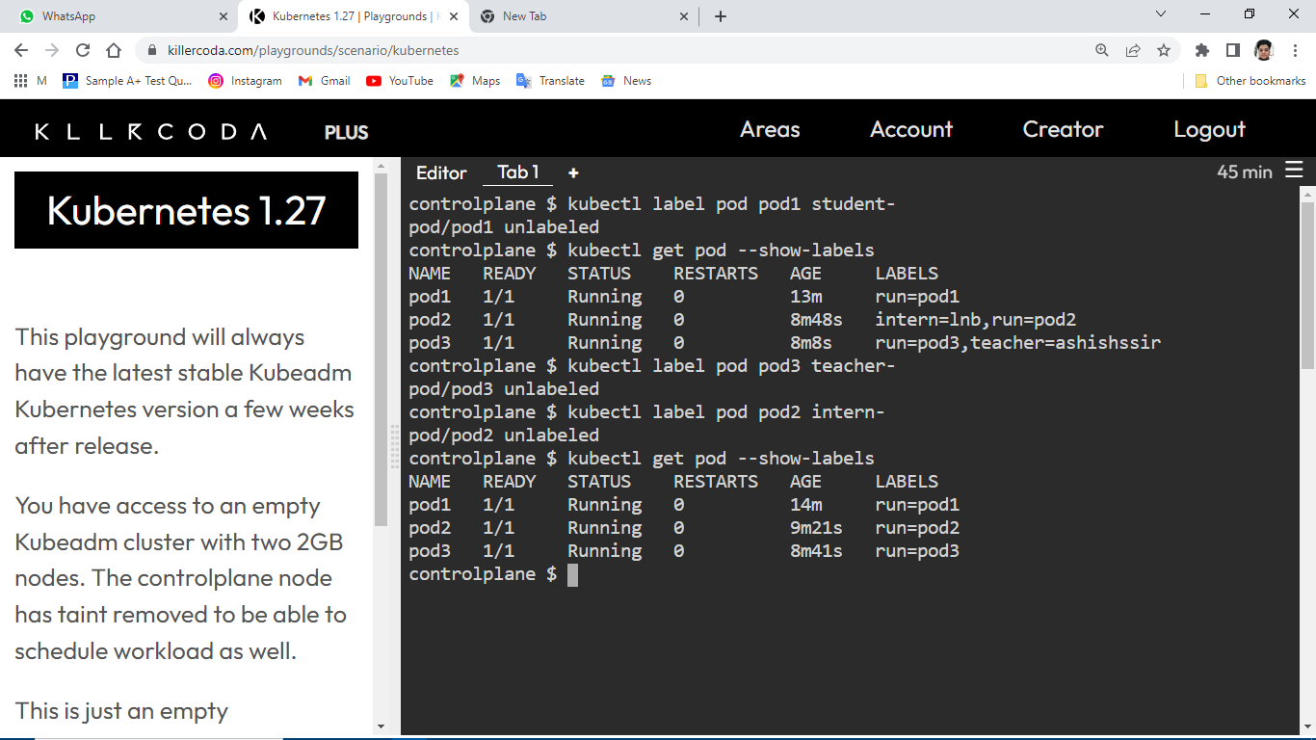

Slide 14


Slide 15


